Slide 1
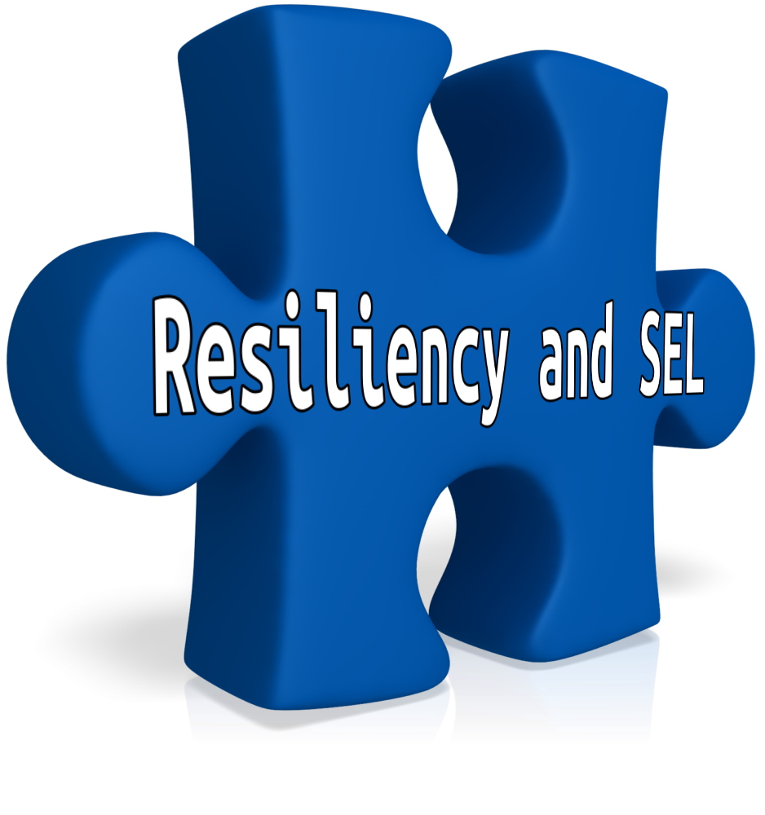
Resiliency: The Missing Piece in Early Warning Systems

Slide 2
One Student’s Story
Suburban HS
Great parents
Involved (Orchestra, choir, part-time work)
Model ABC data (GPA: 3.6; Attendance: 97%; No behavior issues)
Described as kind, well-behaved, happy, smart

Slide 3
One Student’s Story
Felt disconnected
Not a part of the “crowd”
Bored with school
Breakdown
Could not stop crying and couldn’t tell you why
Felt misunderstood
No help from teachers or counselors

Slide 4
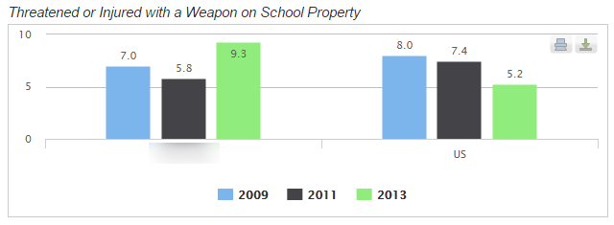
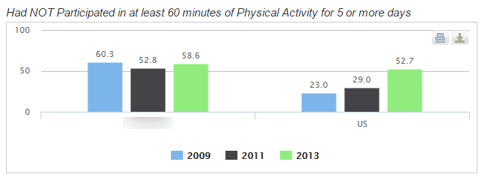
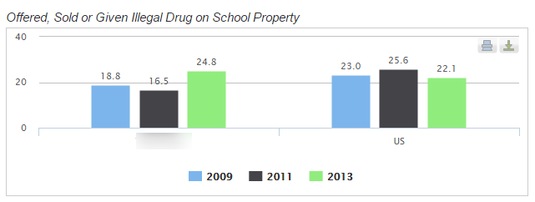
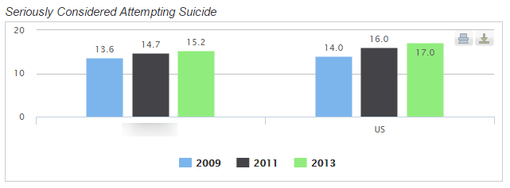
The Hard Realities
700,000 Kids (16-19 years old) were not in school in 2014
* Source: Kids Count Data Center
5400 Kids attempt suicide everyday
* Source: The Jason Project
* Source: Safe Supportive Learning and CDCP

Slide 5
Early Warning System (EWS)
System that alerts school community members (educators, parents, and students) when a student falls off track.
Source: Nagel (2015)
Data systems that use validated indicators to identify students at risk of missing key educational milestones such as high school graduation.
Source: American Institutes for Research (2013)

Slide 6
EWS Indicators Should Be
Valid for intended purpose
Actionable by schools
Meaningful and easily understood
Aligned to district and school priorities
Source: Nagel (2015)

Slide 7
Adding Resiliency to the Equation
Attendance
Behavior
Course Completion and Quality
Resiliency and SEL
Value Education
Academic Confidence
Connections
Stress
Health and Well-Being
Motivation

Slide 8
Keys to Assessing Resiliency
Evidence-Based (preferably longitudinal)
Malleable Skills
Universal – not clinical/targeted
Monitor at district, school, and individual levels
Easy to administer and interpret
Fits into tier-based structures (comparable data)
Help get to the “Now, what” question

Slide 9
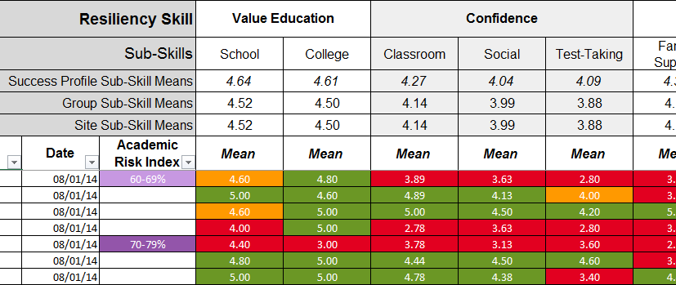
Resiliency Data

Slide 10
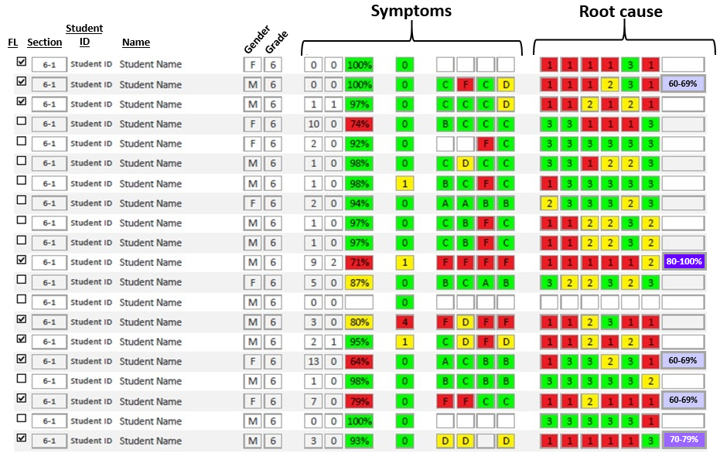
Adding Resiliency to ABC Data

Slide 11
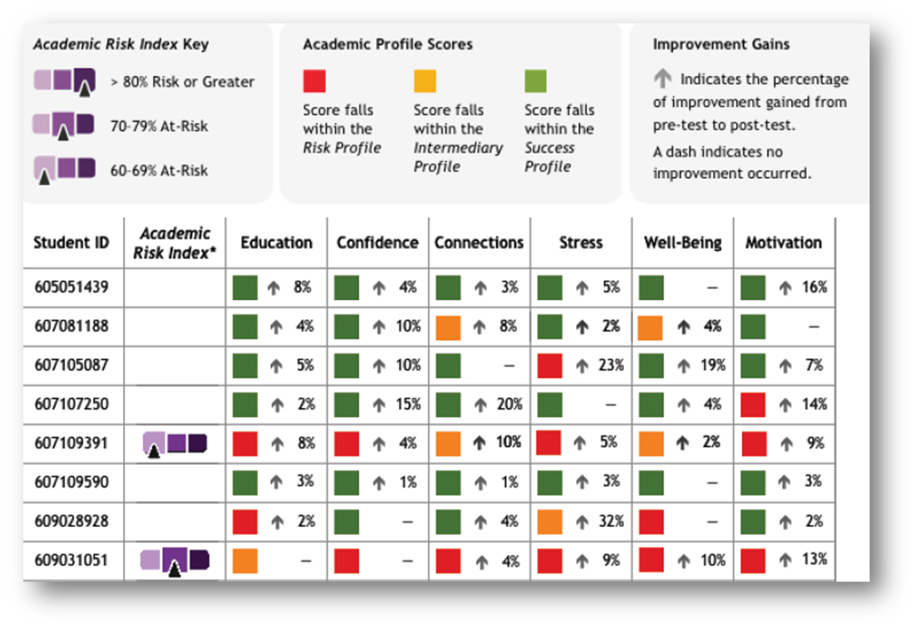
Did Our Intervention Work?

Slide 12
Address Resiliency at All Levels

Slide 13
Resiliency Aids Teaching Effectiveness
Use SEL Early Warning signs that predict those students likely to disengage before they exhibit off-track A-B-C indicators
Establish relevant, authentic, longer lasting connections with more students
Understand the root cause and have greater ability to personalize learning
Understand the trajectory of each student’s college and career readiness early enough to intervene effectively and impact positive change
Identify students ready for more academic rigor (and those that are not ready); target interventions more effectively within an RTI framework
Reduce costs when more complete and accurate student information helps you design more effective interventions
Pressure test the effectiveness of multi-tiered support systems and reduce spending on ineffective strategies
Modify school culture and climate programs, PBIS, and restorative justice initiatives to foster a safer, more positive learning environment

Slide 14
Final Food for Thought
Advocate for Resiliency and SEL as one of the non-academic indicators for ESSA
Adding Resiliency and SEL could be the difference between an intervention and an autopsy
Look for longitudinal evidence that has held up over time

Slide 15
Resiliency: The Missing Piece in Early Warning Systems
LeAnn Stewart, VP Curriculum and Instruction
AdvancePath Academics

