Slide 1
Is Recess the Most Underutilized Opportunity in Schools Today?
David S. Fleming, PhD
Clemson University

Slide 2
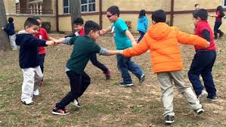
Overview
What is recess (and what is it not)?
Current status of recess including policies
Recess elsewhere
Organizational positions on recess
Recess and academic impact
Recess and physical activity/health
Recess and social skill development
Recess – Should it be unstructured or structured?
Recess for purposeful leisure time development
What can you do to support recess?

Slide 3
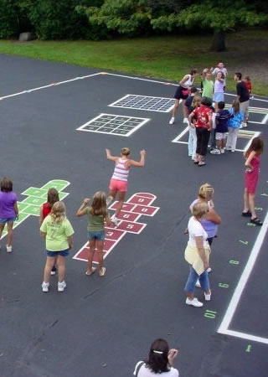
What is Recess
Regularly scheduled periods within the elementary school day for unstructured physical activity and play (CDC)
Break time from standard academics when children engage in
Chase games
Ball games
Jumping/verbal games
General play
Choose to do what they want to do and with whom
Recess time in America ranges primarily from 20 to 60 minutes per day…when allocated

Slide 4
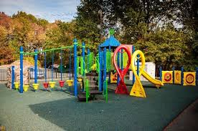
What Recess is Not (or should not be)
A replacement for Physical Education
A waste of unproductive, valuable school day time that can be better spent on academic subjects
A reward that can be taken away for punitive or behavioral reasons

Slide 5
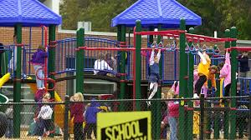
Current Status of Recess
Recess frequency and time allotted have been decreasing since the 1980’s
Decreases have been more pronounced with the enactment of the No Child Left Behind Act
5.3% of school districts report increases in recess time; 32.3% of school districts report decreases in recess time
Average of cuts have been 50 minutes per week
Recess decreases are also more pronounced in
lower SES schools
schools with higher minority populations
urban schools

Slide 6
Current Status of Policies Regarding Recess
School District Level
State Level
60% of districts have no policy regarding daily recess
22% of districts require daily recess
But less than half require at least 20 minutes
Less than 7% of districts require a set amount of physical activity per day
5 states require daily recess
But only 1 requires at least 20 minutes
8 states recommend daily recess
But only 2 recommend at least 20 minutes
10 states require a set amount of physical activity per day
4 states recommend a specific amount of physical activity per day

Slide 7
Recess in Other Countries
Most European Schools spend between 30 and 105 minutes of recess per day
Finland – 67% of school day is academic content, 33% is unstructured outdoor play
Australia, New Zealand, and Canada incorporate at least one hour of “recess” or “free period” per week
Japan – 25% of the school day is spent in non-academic activities
China – Many schools permit 1 to 2 hours per day in social activities including a 10 minute break each class period

Slide 8
Organizational Support for Recess
Children should have 60 minutes of moderate to vigorous physical activity per day.
Centers for Disease Control and Prevention; American Academy of Pediatrics
All elementary school children should be provided at least one daily period of recess of at least 20 minutes in duration.
SHAPE America
Recess is an essential component of education and should be part of the curriculum for preschool through elementary school.
National Association of Early Childhood Specialists in State Departments of Education
Children need both Physical Education and Recess.
SHAPE America; National Association of Elementary School Principals; National Association of State Boards of Education
Recess should not be taken away as punishment.
American Academy of Pediatrics; SHAPE America
Principals should promote the development and maintenance of appropriately supervised free play for children during the school day.
National Association of Elementary School Principals

Slide 9
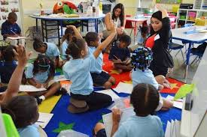
Recess and Academic Impact
Immediately after a recess, students are more attentive and better able to perform cognitively
Children are less fidgety and more on-task after recess (largest impact noted on children with ADHD)
Children raise their hands in class more after recess
Children perform better on literacy tasks after recess
Students perform better when learning via distributed versus mass instruction
Concentrated instruction followed by interruptions of unstructured breaks (not another cognitive task)

Slide 10
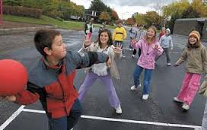
Recess and Physical Activity/Health
Affords the opportunity to engage in physical activity for the joy of movement
Helps contribute to the 60 minutes of moderate to vigorous physical activity recommendations
Opportunity for physical activity has been noted to be higher during recess (42%) than physical education (32%) or after school programs (26%)
Children were less physically active after school on days of no recess or physical activity – no compensation
Recess periods offered before the lunch break have been shown to positively impact
food consumption at lunch and less waste
behavior at lunchtime and afternoon classroom time

Slide 11
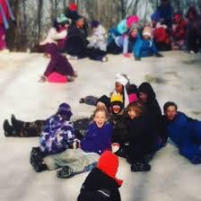
Recess and Social Skill Development
Recess allows children to engage in peer interactions in which they role play essential social skills including
negotiation, cooperation, sharing, problem solving, perseverance, self-control, leadership, coping with and managing stress
Research has found very little negative behavior during recess. Incidents primarily related to transitions
Students desire to negotiate in order to continue participation
Recess is often the only time of the school day when students have authority over their choices

Slide 12
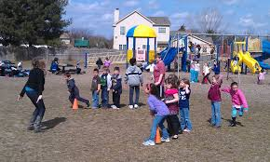
Should Recess be Unstructured or Structured?
Unstructured – Children choose what and how they use the time provided at recess
Purpose – More traditional notion that children “own” this time and need the empowerment to choose their activities
Structured – Games and physical activities are taught and led by a trained adult
Purpose – Children need help in developing games and often require suggestions and encouragement to participate
Benefits include enhanced game play, social skill coaching, higher levels of participation, and improved behavior
Requires appropriately trained personnel
BUT, structured recess should always permit student voice and choice in participation

Slide 13
Recess for Purposeful Leisure Time Development
Smartphone use has exploded among youth
93% use the phone to prevent boredom
47% use the phone to avoid interacting with others around them
Youth are losing the “skill” in purposeful leisure time development
Recess can teach youth how to engage in voluntary, yet productive, leisure activities

Slide 14
What Can You Do to Support Recess?
Researchers – Conduct studies on the impacts of recess not only to support other areas, but as a necessary component of the curriculum for youth development.
Teachers – Continue to read about the importance of recess and communicate it to your local administrators. Also, refrain from using recess as a classroom management technique or for make-up work.
Administrators – Strive to develop policies that support student development through recess allotment both in time and frequency.
Parents – Communicate with local leaders on the importance of recess and the needs to support it through policy.
Students – Continue to play and grow from the recess periods provided and remind teachers and parents that short breaks are needed for you to be able to perform up to your potential…just like everyone else.

Slide 15
Is Recess the Most Underutilized Opportunity in Schools Today?
David S. Fleming, PhD
Clemson University

