Slide 1
Emerging Scholars
Solutions to the Dropout Crisis
October 13, 2015
Amber Lange and Jason Combs

Slide 2
The Need
According to the US Census Bureau, the average poverty rate for the
5 high schools is 25.6%, meaning
1 in 4 people are in poverty
(income of $23,850 or less).

Slide 3
The Need
8th graders tested
below state standards in Math:
Allendale County – 80%
Greenville County – 30%

Slide 4
The Need
Teens ages 16-19
not enrolled in high school,
without high school degree:
Allendale – 19.4%
Greenville – 5.4%

Slide 5
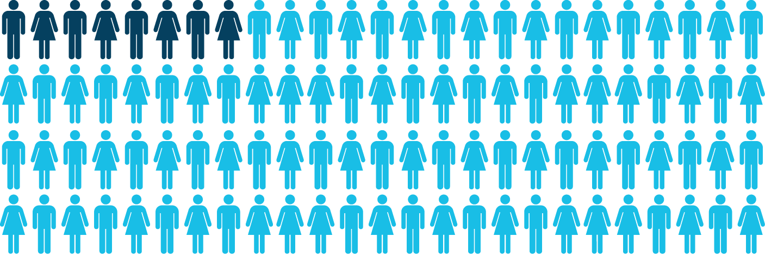
College Graduation Rates
The Facts:
Just 8% of kids growing up in
low-income communities graduate college by age 24.
source: postsecondary.org
Notes:
5
[00:24 – 00:25]
We see the impact of poverty playing out in the educational opportunities for kids at many levels, but this graph really illustrates how significant this disparity is. Right now, just 8 percent of kids growing up in low income communities graduate college by the age of 24…

Slide 6
The Facts:
80% of kids growing up in
high-income communities graduate college by age 24.
source: postsecondary.org
Notes:
6
[00:25 – 00:25]
… compared to 80 percent of kids from high-income communities.
I think it’s pretty obvious that the achievement gap is an injustice on a moral and ideological level, but this isn’t just a theoretical problem. The achievement gap profoundly affects the life prospects of students and families from low-income communities and our country as a whole.

Slide 8
The Impact
90% of these students enter college or the military the year after they graduate from high school
100% of the students to ever be involved with the program graduate from high school (over 500 students have been a part of the program)

Slide 13
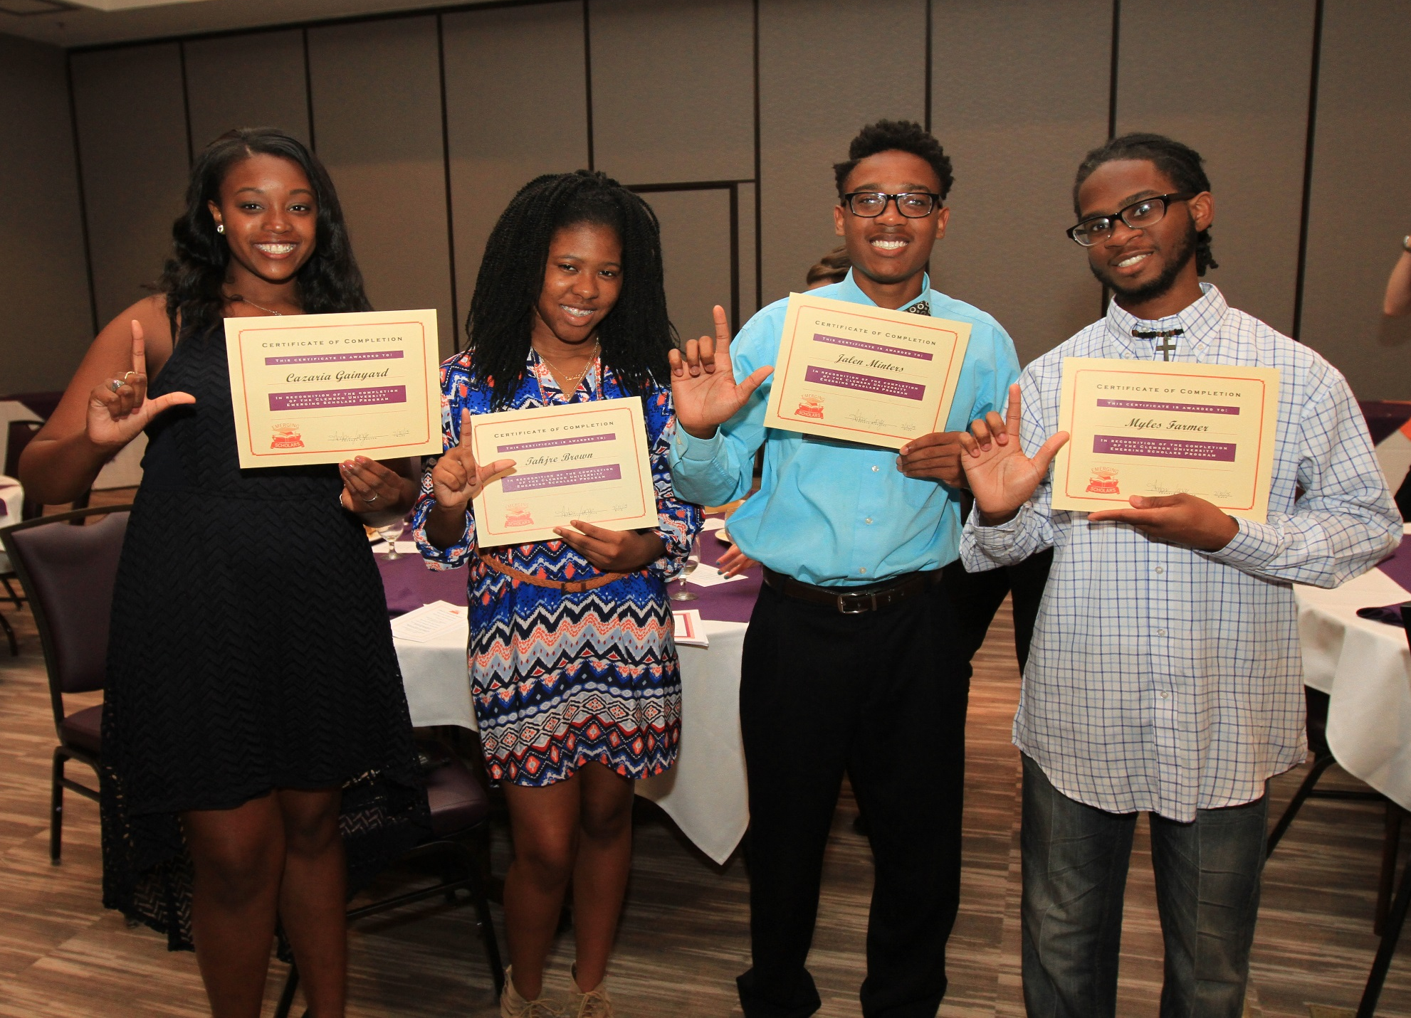

Slide 14
Contact
Amber Lange, Director
864-656-1301 lange@clemson.edu
@TeamES_Clemson
www.clemsonemergingscholars.org

