Slide 1
Dropout Prevention
Everyone’s Problem
Jay Smink, D.Ed.
Retired, Executive Director
National Dropout Prevention
Center/Network
Professor Emeritus
Clemson University
www.dropoutprevention.org
WASA 1

Slide 2
Types of Dropout and
Graduation Rates
According to NCES, its indicators of school dropout and school completion include the following:
Event dropout rate
Status dropout rate
Status completion rate
Averaged freshman graduation rate
(Non-regulatory cohort rate)
(National Center for Education Statistics, 2010. Trends in High School Dropout and Completion Rates in the United States: 1972-2008)

Slide 3
Public High School Event Dropout Rates for Grades 9-12, by Race/Ethnicity: School Year 2009-2010
Source: U.S. Department of Education, National Center for Education Statistics, Common Core of Data (CCD), "NCES Common Core of Data State Dropout and Completion Data File," School Year 2009-2010, Version 1a.

Slide 4
Public High School Averaged Freshman Graduation Rate (AFGR), by Race/Ethnicity: School Year 2009-2010
Source: Institute of Education Sciences, National Center for Education Statistics, (2013) Public School Graduates and Dropouts from the Common Core of Data: School Year 2009-10, First Look (Provisional Data).

Slide 5
Dropout Prevention
A National Issue
American Indian and Alaska Native students have a dropout rate twice the national average - the highest dropout rate of any United States ethnic or racial group
Native American students drop out of school before graduating from high school both on reservations and in cities
Plans for Dropout Prevention & Special School Support Services for American Indian & Alaska Native Students prepared for the Indian Nations at Risk Task Force in 1992
Notes:
The phenomenon of the American Indian school dropout has yet to be thoroughly studied. Estimates of the dropout rate range from 28% to 95% depending on factors such as the definition of dropout, the method used for computing dropouts, and the adequacy of school data.
Brandt, E. A. (1992). The Navajo Area Student Dropout Study: Findings and Implications. Journal of American Indian Education, 31 (2).

Slide 6
Dropout Prevention
A National Issue
8th Grade is Critical for Students with Disabilities
  20% of students with disabilities drop out by 8th grade
  40% of Hispanic students with disabilities drop out by 8th grade
  (Source: Schwartz, 1995)

Slide 7


Slide 8
Economics of High School Dropouts
Earn less
Pay less in taxes
Rely more on public health
More involved in criminal justice system
More likely to use welfare services
(Rotermund, California Dropout Research Project, Statistical Brief 5, September 2007)

Slide 9
Unemployment Rate by Educational Attainment 2012
Doctoral degree...................... 2.5%
Professional degree............... 2.1%
Master’s degree..................... 3.5%
Bachelor’s degree.................. 4.5%
Associate’s degree................. 6.2%
Some college ......................... 7.7%
High school degree................. 8.3%
Less than high school............12.4%
(Bureau of Labor Statistics, May 2013, http://www.bls.gov/emp/ep_chart_001.htm)

Slide 10
Diversity of Influences/Factors
Contributing to School Dropouts
__________________________________________________
A B behavior C
L M N nutrition
X Y Z zero tolerance

Slide 11
Reasons for Dropping
Out of School
Students who considered dropping out of high school
gave these reasons for considering this option:
I didn’t like the school………………………………………….. 73%
I didn’t like the teachers ………………………………………. 61%
I didn’t see value in the work I was being asked to do…….. 60%
I had family issues …………………………………………….. 42%
I needed to work for money…………………………………… 35%
I was picked on or bullied……………………………………… 28%
No adults in the school cared about me……………………... 24%
The work was too easy………………………………………… 19%
(Yazzie-Mintz, “Voices of Students on Engagement: A Report on the 2006 High School Survey of Student Engagement”)

Slide 12
Dropout Rates Related to Socioeconomic Status
Family Income Level Dropout Rate
  Quintile 1 38%
  Quintile 2 22%
  Quintile 3 15%
  Quintile 4/5 8%
(Jobs for the Future, 2006)
Notes:
Which children are most likely to drop out? The fact is most of the children will be from low-income families. These are the children who must fight the odds of an uneven playing field both because of their poverty and because of the inadequate resources devoted to their schools.
Poverty is the major variable predicting low educational achievement.
Predictable Casualities,Education Week, Mary Hatwood Futrell and Iris C. Rotberg. October 2, 2002

Slide 13

Grade Retention and
School Dropout
Retention of one grade –
increases risk by 40%
Retention of two grades –
increases risk by 90%
(Roderick, M. PDK Research Bulletin, No. 15, 1995)

Slide 14
Barriers and Risks for Girls
Pregnancy and family responsibilities
  33% of dropouts are pregnant before exiting
Attendance rates
  9% more girls than boys cite attendance as a factor
Academics
  African American, Hispanics & Native Amer./Alaskan Natives drop out at a higher rate than males or Caucasians
Discipline
  12th grade Hispanic females’ dropout rate skyrockets
Family structure and rules
(When Girls Don’t Graduate, We All Fail, 2007)

Slide 15
What key indicator is the best predictor of a school dropout?
Attendance
Reading Level
Free and reduced lunch
Academic achievement
Discipline referrals

Slide 16

Research Domain Factors
  Individual
  Family
  School
  Community

Slide 17

Individual Factors…contributing to students dropping out
Lacks future orientation
Inadequate peer relationships
Drug abuse
Pregnancy
Special learning needs
Depression

Slide 18

Family Factors…contributing to students dropping out
Poverty
Low expectations
Abuse
Mobility of family
Parent level of education
Language and literacy levels

Slide 19
School Factors…contributing to students dropping out
  Lack of program for challenged students
  No significant, interested adult
  Lack of alternatives for learning
  Lack of active learning instruction
  No individual learning plans
  Behavior and discipline issues
  Retention policies

Slide 20
Community Factors…contributing to students dropping out
Lack of involvement with schools
Lack of support for schools
Non-caring environment
Low expectations
Violence
Few recreational facilities

Slide 21
Risk Factors by School Levels
Individual Factors | Elem. | Middle | High
Has a learning disability or emotional disturbance |  | ✔ | ✔
High number of work hours |  | ✔ | ✔ ←
Parenthood |  |  | ✔ ←
High-risk peer group |  | ✔ ← | ✔
High-risk social behavior |  | ✔ ← | ✔
Highly socially active outside of school |  |  | ✔
Low achievement | ✔ ← | ✔ ← | ✔ ←
Retention/overage for grade | ✔ ← | ✔ ← | ✔←
Poor attendance | ✔ ← | ✔ ← | ✔ ←
Low educational expectations |  | ✔ ← | ✔ ←
Lack of effort |  | ✔ | ✔
Low commitment to school |  | ✔ | ✔ ←
No extracurricular participation |  | ✔ | ✔ ←
Misbehavior | ✔ | ✔ | ✔ ←
Early aggression | ✔ | ✔

Slide 22
Risk Factors by School Levels
Family Factors | Elem. | Middle | High
Low socioeconomic status | ✔ ← | ✔ ← | ✔ ←
High family mobility |  | ✔ ←
Low education level of parents | ✔ | ✔ | ✔ ←
Large number of siblings | ✔ |  | ✔
Not living with both natural parents | ✔ | ✔ | ✔ ←
Family disruption | ✔
Low educational expectations |  | ✔ ←
Sibling(s) has dropped out |  | ✔ | ✔
Low contact with school |  | ✔ ←
Lack of conversations about school |  | ✔ ← | ✔
Key: ✔ One (1) research study
✔ ← Two (2) or more research studies
Hammond, C., Smink, J., & Drew, S. (2007). Dropout risk factors and exemplary programs: A technical report, pg. 6. Retrieved from www.dropoutprevention.org/major-research-reports/dropout-risk-factors-exemplary-programs-technical-report

Slide 23
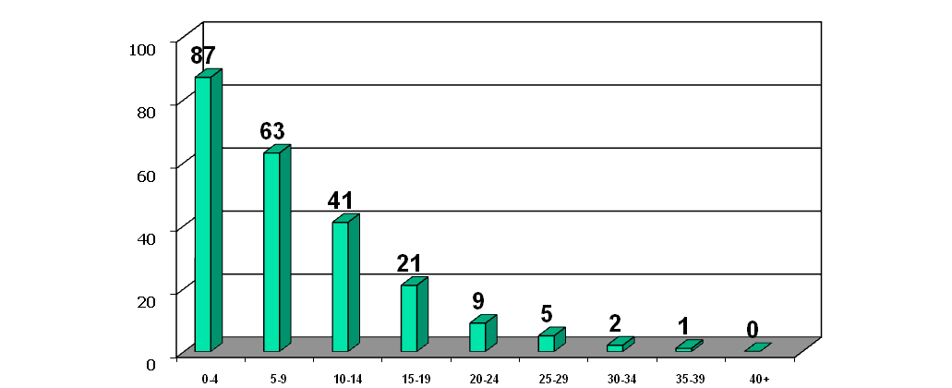
What Really Matters?
Attendance Affects Graduation
% Graduated in Four Years
Days Absent Per Semester
Course cutting counted as partial days
(The Consortium on Chicago School Research at the University of Chicago, 2007)

Slide 24
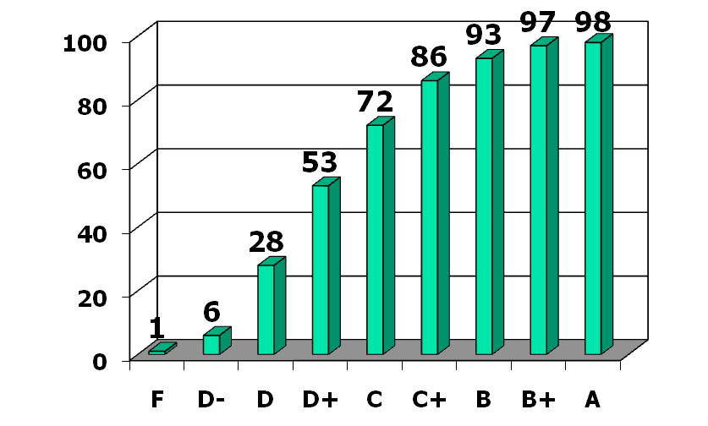
What Really Matters?
Grades Affect Graduation
% Graduated in Four Years
Average Freshman Grades
Rounded to the nearest 0.5
(The Consortium on Chicago School Research at the University of Chicago)

Slide 25
Variables Associated
With Dropouts
Status Variables
Age, gender
Socioeconomic background
Ethnicity
Native language
Mobility
Family structure
(Lehr et al., Essential Tools, 2004)

Slide 26

Variables Associated
With Dropouts
Alterable Variables
Grades, retention
Disruptive behavior
Absenteeism
School policies, climate
Sense of belonging
Attitude toward school
Support in the home
(Lehr et al., Essential Tools, 2004)

Slide 27
While no one factor (or even several factors) assures students will not graduate; multiple factors can help identify potential dropouts.
DEWS

Slide 28


Slide 29
Institute of Education Sciences
Practice Guide Recommendations
1. Utilize data systems that support a realistic diagnosis of the number of students who drop out and that help identify individual students at high risk of dropping out (diagnostic)
2. Assign adult advocates to students at risk of dropping out (targeted intervention)
3. Provide academic support and enrichment to improve academic performance (targeted intervention)
4. Implement programs to improve students’ classroom behavior and social skills (targeted intervention)
5. Personalize the learning environment and instructional process (schoolwide intervention)
6. Provide rigorous and relevant instruction to better engage students in learning and provide the skills needed to graduate and to serve them after they leave school (schoolwide intervention)

Slide 30
What Works Clearinghouse-
Related Interventions Showing Positive or Potentially Positive Effects
Achievement for Latinos with Academic Success (ALAS)
Career Academies
Check and Connect
High School Redirection
Talent Development
Talent Search
Twelve Together

Slide 31
Check Sheet For Recommendations
Recommendation 1. Utilize data systems that support a realistic diagnosis of the number of students who drop out and that help identify individual students at high risk of dropping out | Presence |  | Level of Success |  |  |  | Restudy
Checklist | Yes | No | VG | G | A | P | Yes | No | ?
Use longitudinal, student-level data to get an accurate read of graduation and dropout rates.
Use data to identify incoming students with histories of academic problems, truancy, behavioral problems, and retentions.
Monitor the academic and social performance of all students continually.
Review student-level data to identify students at risk of dropping out before key academic transitions.
Monitor students’ sense of engagement and belonging in school. |  | √ |  |  |  |  | √
Collect and document accurate information on student withdrawals. | √ |  |  |  | √ |  | √
Comments:
Legend: VG=Very Good, G=Good, A=Average, P=Poor

Slide 32
Check Sheet For Recommendations
Recommendation 2. Assign adult advocates to students at risk of dropping out | Presence |  | Level of Success |  |  |  | Restudy
Checklist | Yes | No | VG | G | A | P | Yes | No | ?
Choose adults who are committed to investing in the student’s personal and academic success, keep caseloads low, and purposefully match students with adult advocates.
Establish a regular time in the school day or week for students to meet with the adult.
Communicate with adult advocates about the various obstacles students may encounter—and provide adult advocates with guidance and training about how to work with students, parents, or school staff to address the problems.
Comments:
Recommendation 3. Provide academic support and enrichment to improve academic performance | Presence |  | Level of Success |  |  |  | Restudy
Checklist | Yes | No | VG | G | A | P | Yes | No | ?
Provide individual or small group support in test-taking skills, study skills, or targeted subject areas such as reading, writing, or math.
Provide extra study time and opportunities for credit recovery and accumulation through after school, Saturday school, or summer enrichment programs.
Comments:
Legend: VG=Very Good, G=Good, A=Average, P=Poor

Slide 33
Check Sheet For Recommendations
Recommendation 4. Implement programs to improve students’ classroom behavior and social skills | Presence |  | Level of Success |  |  |  | Restudy
Checklist | Yes | No | VG | G | A | P | Yes | No | ?
Use adult advocates or other engaged adults to help students establish attainable academic and behavioral goals with specific benchmarks.
Recognize student accomplishments.
Teach strategies to strengthen problem-solving and decision-making skills.
Establish partnerships with community-based program providers and other agencies such as social services, welfare, mental health, and law enforcement.
Comments:
Recommendation 5. Personalize the learning environment and instructional process | Presence |  | Level of Success |  |  |  | Restudy
Checklist | Yes | No | VG | G | A | P | Yes | No | ?
Establish small learning communities.
Establish team teaching.
Create smaller classes.
Create extended time in classroom through changes to the school schedule.
Encourage student participation in extracurricular activities.
Comments:
Legend: VG=Very Good, G=Good, A=Average, P=Poor

Slide 34
Check Sheet For Recommendations
Recommendation 6. Provide rigorous and relevant instruction to better engage students in learning and provide the skills needed to graduate and to serve them after they leave school | Presence |  | Level of Success |  |  |  | Restudy
Checklist | Yes | No | VG | G | A | P | Yes | No | ?
Provide teachers with ongoing ways to expand their knowledge and improve their skills.
Integrate academic content with career and skill-based themes through career academies or multiple pathways models.
Host career days and offer opportunities for work-related experiences and visits to postsecondary campuses.
Provide students with extra assistance and information about the demands of college.
Partner with local businesses to provide opportunities for work-related experience such as internships, simulated job interviews, or long-term employment.
Comments:
Legend: VG=Very Good, G=Good, A=Average, P=Poor

Slide 35
Develop a Targeted Intervention Plan
Identify students at risk of dropout by examining risk and protective indicators
Determine the specific needs of the student/cohort
Determine the level of need
Recommend the most effective interventions
Utilization of Data for Identification, Selection, and Implementation of Intervention Strategies
Focus of Identification | Specific Need | Levels of Need | Intervention Strategies
Individual Students | Academic (math) | Medium | Individual Growth Plan Academic Restructuring Peer Monitoring Support
Student Clusters | English Language | High | Tutors After-school Programs

Slide 36
Develop a Schoolwide Intervention Plan
Implement risk assessment framework to examine risk and protective factors to determine the most effective intervention plan(s).
Utilization of Data for Identification, Selection, and Implementation of Intervention Strategies
Focus of Identification | Specific Need | Levels of Need | Intervention Strategies
Grade Level | 9th Reading Attendance Transition | High High High | Freshman Academies Check and Connect Peer Mentors
School Level | Discipline | Low | Conflict Resolution
District Patterns | Suspensions Retentions | Medium High | Behavior Mod. Reinforcement Review Policies
District & Community | Truancy Gangs Drug Abuse | High High High | Family Court, Olweus Gang Intervention Classroom Multidimensional Family Therapy

Slide 37
15 Strategies That Help Prevent Students From Dropping Out

Slide 38
Dropout Prevention:
Everyone’s Problem
Systemic Renewal
Early
Interventions
Learning
Basic
Core
Strategies
Early Interventions
School-Community Collaboration
School-Community Collaboration
Basic
Core
Strategies
Systemic Renewal
Environments
Safe
Systemic Renewal
Instructional
Practices
Instructional
Practices

Slide 39
A School and
Community Perspective
  Systemic renewal
  School and community collaboration
  Safe learning environments

Slide 40
Systemic Renewal
  Policies
  Populations
  Personnel
  Perpetual
  Performance
  Pathways
  Partners
  Pennies
Personnel
Programs
Practices
Populations
Partners
Policies
Systemic
Renewal
Pennies

Slide 41
Systemic Renewal
Processes for Continuous Improvement
Involve all stakeholders
Share decision-making
Map assets
Identify problems
Allocate resources
Evaluate program

Slide 42
School-Community Collaboration
Schools Cannot Do It Alone
Community agencies
Faith-based community
Business/Industry
Volunteers
Parents

Slide 43
Creating Safe Learning Environments
A safe learning environment:
  Provides a warm and welcoming atmosphere that fosters a spirit of acceptance and caring
  Is free of intimidation, violence, and fear
  Clearly communicates behavior expectations consistently enforced and fairly applied

Slide 44
Dropout Prevention:
Everyone’s Problem
Systemic Renewal
Early
Interventions
Learning
Early Interventions
Basic
Core
Strategies
School-Community Collaboration
School-Community Collaboration
Basic
Core
Strategies
Systemic Renewal
Environments
Safe
Instructional
Practices
Systemic Renewal
Instructional
Practices

Slide 45
Early Interventions
  Early Childhood Education
  Early Literacy Development
  Family Engagement

Slide 46
Early Childhood Education
Best Practices in Early Childhood Education
  Infants (Birth to three years)
  Encourage conversations by parents and adults
  Exposures to different
  social settings
(Stegelin, 2004)

Slide 47
Early Childhood Education
Best Practices in Early Childhood Education
  Preschool Children (3-5 year olds)
  Use all sensory experiences
  Provide print-rich environments
(Stegelin, 2004)

Slide 48
Early Childhood Education
Best Practices in Early Childhood Education …
  K-Primary Children
  Provide hands-on and exploratory activities
  Encourage reading and small group work
(Stegelin, 2004)

Slide 49
Early Literacy Development
Research
  At-risk students who have a strong reading teacher for two consecutive years can be successful readers. (Wren, 2003)
  Reading aloud to children is the single most important activity for building the knowledge required for success in reading.
(Armbruster, Lehr, & Osborn, 2002)

Slide 50

Closing the Gap in 3rd Grade Reading Level
Early Literacy Development
Quality program and start early
Use child's affinity for technology
Use data to drive instruction
Extra support of disadvantaged
Engage entire community
(Education Week, p 23, R. Lauer, May 7, 2008)

Slide 51
Family Engagement
When families are engaged in children’s learning, students are more likely to:
  Attend school regularly
  Display more positive attitudes about school
  Graduate from high school and enroll in postsecondary programs
  Refrain from destructive activities such as alcohol use and violence
(Henderson & Mapp, 2003)

Slide 52
Research: Dropout Pathway
Dropping out of school is the result of a long process of disengagement that may begin before a child enters school.

Slide 53
Dropout Prevention:
Everyone’s Problem
Systemic Renewal
Learning
Early
Interventions
Basic
Core
Strategies
Early Interventions
School-Community Collaboration
Basic
Core
Strategies
School-Community Collaboration
Safe
Environments
Systemic Renewal
Instructional
Practices
Systemic Renewal
Instructional
Practices

Slide 54
Basic Core Strategies
  Mentoring
  Service-Learning
  Alternative Schooling
  After-School Program Experiences

Slide 55
Mentoring
Mentoring is …
A caring and supportive relationship between a mentor and mentee that is based on trust.

Slide 56

Mentoring
Mentoring has many formats …
  Traditional: One adult with one student
  Peer: One older youth with a younger youth
  Group/Team: One or more adults with several youth
  Telementoring: One adult with one youth using the
  Internet

Slide 57
Service-Learning
Essential Elements of Good Service-Learning Programs…
  Is integrated into the curriculum
  Utilizes active learning
  Is interesting and exciting
  Is connected to community

Slide 58


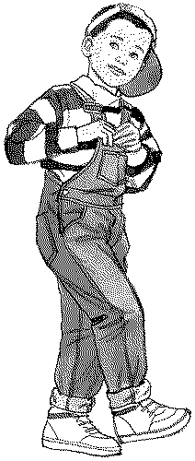
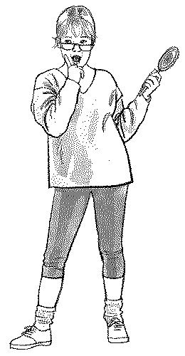

Alternative Schooling
Traditional schools can no longer meet the diverse needs of every student.
Alternative Education is a perspective, not a procedure or program.

Slide 59
Alternative School Elements
  Maximum Teacher/Student Ratio of 1:10
  Small student base not exceeding 250
  Caring faculty and ongoing staff development
  High expectations from school staff
  Flexible school schedule with community involvement and support
  Heavy emphasis on credit recovery and catching up

Slide 60

After-School
Program Experiences
Components of Successful Programs
  Academic focus
  Enrichment and accelerated learning
  Supervised recreation
  Community service
  Collaboration and partnerships
  Active family involvement

Slide 61
Summer Learning & the Achievement Gap
Summer Reading Achievement
Average Reading Achievement Level
Middle-Income Students
Low-Income Students
K
Summer
1st
Summer
2nd
Summer
3rd
Summer
4th
Summer
National Center for Summer Learning,, 2010, http://www.dropoutprevention.org/sites/default/files/uploads/webcast/slides_20100608.pdf
Notes:
The rate of learning in school year is the same—SUMMER is where the slide back occurs
ACTIVITY (see below)
By the end of fifth grade, low-income children are approximately 2 ½ years behind their more affluent peers, primarily because of summer learning loss.
HIGHLIGHT the Memorable Summer Sheet
Let them know how they can use these facts; grants, attendance, etc…
Activity: Physical Demonstration
This physical demonstration shows reading achievement of low income and middle income students who did not participate in a summer learning program.
Choose two volunteers; assign one to represent a child from a middle income home (MI) and a child from a low income home (LI). Explain that the volunteers must walk "heel to toe" during the demonstration.
Summer before Kindergarten
MI, LI stand side by side
LI take one step back
? Why does the lower income student start out behind?
Lack of books, exposure
Lack of exposure to different places and experiences
Little interaction with other youth or caring adults
Kindergarten year
MI, LI take 8 steps forward
Summer
MI=1/2 step forward
LI=2 steps back
First grade
MI, LI take 8 steps forward
Summer
MI=1/2 step forward
LI=2 steps back
?What is happening during the school year?
Both MI and LI are learning at the same rate. It is in summer where the gap widens. For disadvantaged kids, school is the main source for their academic learning.[1]
Second Grade
MI, LI take 8 steps forward
Summer
MI=1/2 step forward
LI=2 steps back
By the end of fifth grade, low-income children are approximately 2 ½ years behind their more affluent peers, primarily because of summer learning loss. Some researchers believe that summer learning losses are the main cause of the widening achievement gaps between low-income minority and white middle-class students in the United States.[2]
[1] Seppanen, P., deVries, D., and Seligson, M. (1993) National study of before- and afterschool
programs.Washington, DC: Office of Policy and Planning, U.S. Department
of Education.
[2] Alexander, K. L., Entwisle, D. R., & Olsen, L. S. (2004). Schools, achievement, and
inequality. In G. D. Borman, & M. Boulay (Eds.), Summer learning: Research, policies,
and programs (pp.25-52). Mahwah, NJ: Lawrence Erlbaum Associates.

Slide 62

Making the Most of Instruction
  Professional development
  Active learning
  Educational technology
  Individualized instruction
  Career and technical education

Slide 63
Professional Development
Effective Professional Development Strategies….
  Sustained, rather than one-shot presentations (Garet, Porter, Desimone, Birman, & Kwang, 2001)
  Tied to student achievement and school improvement goals (U.S. Department of Education, 2003)
  Focused on deepening teachers’ content knowledge and pedagogical skills (Sparks, 2002)

Slide 64



Active Learning
Differentiated Learning Strategies:
Cooperative learning
Multiple intelligences/learning styles theory
Project-based learning

Slide 65
Multiple Intelligences
Key Elements of MI
Verbal/linguistic
Logical/mathematical
Musical
Visual/spatial
Bodily/kinesthetic
Interpersonal
Intrapersonal
Naturalist

Slide 66
Educational Technology
Research on the Use of Technology in schools…
  Is a positive influence on students at risk of failure (Day, 2002)
  Teaches “real-world applications” to help students succeed outside the classroom
  Increases student motivation, raises the success rate of students performing complex tasks, and changes classroom roles and organization
(Means, 1997)

Slide 67
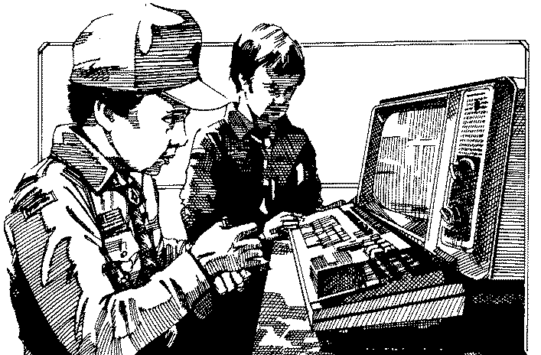
Individualized Instruction
Encourages the learner to be the producer of knowledge with...
  Problem-based learning
  Peer tutoring
  Cooperative learning
  Journaling
  Hands-on projects
  Role playing and simulations

Slide 68
Career and
Technical Education
Career and Technical Education (CTE) includes a wide array of career-based instruction
  K-12 career education
  A comprehensive guidance program
  School- and work-based experiences
  Internships and apprenticeships

Slide 69
Dropout Prevention is Not
Rocket Science,
but it is
Brain Surgery
Academic
Achievement
Behavior Modification
Civic Responsibility

Slide 70
National Trends and Tips
  Alternative Schooling and Recovery Programs
      Virtual credit recovery
      Private contract and charter schools
  Attendance and Truancy Reduction Program
      Aggressive attendance programs by school districts
      and communities
      Court-based programs aligned with school efforts
  Increased Role of “Counselors”
      Graduation coaches (GA)
      Guidance technicians (St. Paul, MN)

Slide 71
National Trends and Tips
  Individualized Learning Plans
      Individual Graduation Plan (South Carolina)
      Six-Year Plan (St. Paul, MN)
  Smaller Learning Communities
      Ninth grade academies
      Smaller “houses” within high schools
  Transition Programs
      Formal programs between 8th and 9th grades
      Transition counselors throughout multiple grade
      levels

Slide 72


Choices Are
NEVER
This Obvious
Drop Out
of
School
Stay
in
School
72

